Slide 1

Aligning Decision Support and Data Analytics
- Supervisor: John Keane
Objectives :
Feature Selection with AHP method
better decision making to meet specific user’s preference
RQs :
1 . which features should we preserve and
which of them should be discarded ?
2. how could we achieve the features above ?
3. could we merge the feature by ourselves manually ?
4. how could decision meets the preferences of user respectively ?
02-11-2020 week 2

Slide 2
Search strings
“AHP( Analytic Hierarchy Process)” AND“feature selection or dimension reduction”AND “decision making”
“AHP( Analytic Hierarchy Process)” AND“feature selection”AND “decision making”
“AHP( Analytic Hierarchy Process)” AND“dimension reduction”AND “decision making”
Search result
02-11-2020 week 2

Slide 3
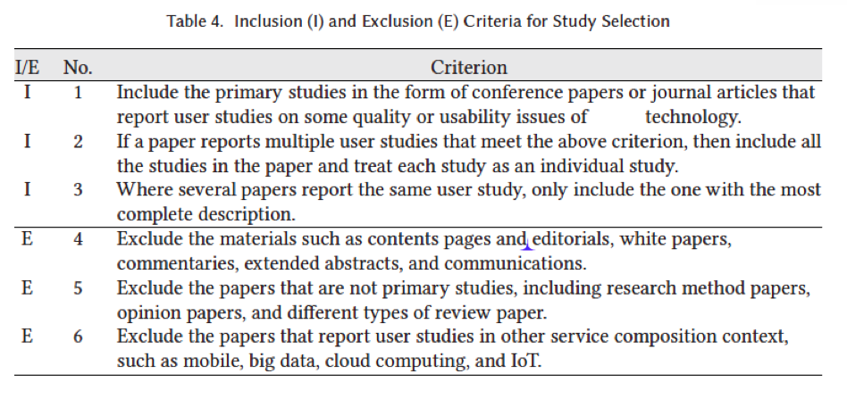
Inclusion and Exclusion Criteria
AHP
02-11-2020 week 2

